Slide 1
CMSC201
Computer Science I for Majors
Lecture 25 – Algorithmic Analysis

Slide 2
Last Class We Covered
Sorting algorithms
  Bubble Sort
  Selection Sort
  Quicksort
Searching algorithms
  Linear search
  Binary search

Slide 3
Any Questions from Last Time?

Slide 4
Today’s Objectives
To learn about asymptotic analysis
  What it is
  Why it’s important
  How to calculate it
To discuss “run time” of algorithms
  Why one algorithm is “better” than another

Slide 5

Alphabetizing a Bookshelf
Video from https://www.youtube.com/watch?v=WaNLJf8xzC4

Slide 6
Run Time

Slide 7
Run Time
An algorithm’s run time is the amount of “time” it takes for that algorithm to run
  “Time” normally means number of operations or something similar, and not seconds or minutes
Run time is shown as an expression, which updates based on how large the problem is
Run time shows how an algorithm scales, or changes with the size of the problem

Slide 8
Example: Fibonacci Recursion
Ideally, we want an algorithm that runs in a reasonable amount of time, no matter how large the problem
Remember the recursive Fibonacci program?
  It runs within one second for smaller positions
  But the larger the position we ask for, the longer and longer it takes

Slide 9
Fibonacci Recursion
  python fibEx.py (with position < 30):
  < 1 second
  python fibEx.py (with position = 30):
  2 seconds
  python fibEx.py (with position = 35):
  8 seconds
  python fibEx.py (with position = 40):
  76 seconds

Slide 10
Fibonacci Recursion
  python fibEx.py (with position = 50):
  Guess!
  9,493 seconds
  2 hours, 38 minutes, 13 seconds!!!

Slide 11
Run Time for Linear Search
Say we have a list that does not contain what we’re looking for.
How many things in the list does linear search have to look at for it to figure out the item’s not there for a list of 8 things?
16 things?
32 things?

Slide 12
Run Time for Binary Search
Say we have a list that does not contain what we’re looking for.
What about for binary search?
  How many things does it have to look at to figure out the item’s not there for a list of 8 things?
  16 things?
  32 things?
Notice anything different?

Slide 13
Different Run Times
These algorithms scale differently!
  Linear search does an amount of work
  equal to the number of items in the list
  Binary search does an amount of work
  equal to the log₂ of the numbers in the list!
By the way, log₂(x) is basically asking “2 to what power equals x?” (normally shown as lg(x) )
  This is the same as saying, “how many times
  must we divide x in half before we hit 1?”

Slide 14
Bubble Sort Run Time
For a list of size N, how much work do we do for a single pass?
  N
How many passes will we have to do?
  N
What is the run time of Bubble Sort?
  N²

Slide 15
Selection Sort Run Time
What is the run time of finding the lowest number in a list?
For a list of size N, how many elements do
you have to look through to find the min?
N

Slide 16
Selection Sort Run Time
For a list of size N, how many times would we have to find the min to sort the list?
N
What is the run time of this sorting algorithm?
N²

Slide 17
Quicksort Run Time
For a list of size N, how many steps does
it take to move everything less than the
“pivot” to the left and everything greater
than the “pivot” to the right?
N

Slide 18
Quicksort Run Time
How many times will the algorithm divide the list in half?
lg(N)
What is the run time of Quicksort?
N * lg(N)

Slide 19
Different Run Times
As our list gets bigger and bigger,
which of the search algorithms is faster?
  Linear or binary search?
How much faster is binary search?
  A lot!
  But exactly how much is “a lot”?

Slide 20
Asymptotic Analysis

Slide 21
What is “Big O” Notation?
Big O notation is a concept in Computer Science
  Used to describe the complexity
  (or performance) of an algorithm
Big O describes the worst-case scenario
  Big Omega (Ω) describes the best-case
  Big Theta (Θ) is used when the best and worst
  case scenarios are the same

Slide 22
A Simple Example
Say we write an algorithm that takes in an list of numbers and returns the maximum
  What is the absolute fastest it can run?
    Linear time – Ω(N)
  What is the absolute slowest it can run?
    Linear time – O(N)
  Are these two values the same?
    YES – so we can also say it’s Θ(N)

Slide 23
Simplification
We are only interested in the growth rate as an “order of magnitude”
  As the problem grows really, really, really large
We are not concerned with the fine details
  Constant multipliers are dropped
    So O(3 * N²) becomes simply O(N²)
  Lower order terms are dropped
    So O(N³ + 4N²) becomes simply O(N³)

Slide 24
Asymptotic Analysis
For a list of size N, linear search does N operations. So we say it is O(N) (pronounced “big Oh of n”)
For a list of size N, binary search does lg(N) operations, so we say it is O(lg(N))
The function inside the O() parentheses indicates how fast the algorithm scales

Slide 25
Worst Case vs Best Case
Why differentiate between the two?
Think back to selection sort
  What is the best case for run time?
  What is the worst case for run time?
They’re the same!
  Always have to find each minimum by looking through the entire list every time – Θ(N²)

Slide 26
Bubble Sort Run Times
What about bubble sort?
  What is the best case for run time?
  What is the worst case for run time?
Very different!
  Best case, everything is already sorted – Ω( N )
  Worst case, it’s completely backwards – O( N² )

Slide 27
Quicksort Run Times
What about quicksort?
  Depends on what the “hinge” or “pivot” is
This determines how many times we split
  But each split, we’ll need to compare each item
  to the hinge in their respective part: O( N )
Best case, pivot is exact center – Ω( N*lgN )
Worst case, it’s an “edge” item – O( N² )

Slide 28
Worst-case vs Best-case
This is why, even though all three sorting algorithms have same worst case run times...
  Quicksort often runs very, very quickly
  Bubble Sort often runs much faster than Selection
How does this apply to linear search and binary search? What are the best and worst run times for these?

Slide 29
Search Run Times
Linear search:
  Best case: Ω( 1 )
  Worst case: O( N )
Binary search:
  Best case: Ω( 1 )
  Worst case: O( lg(N) )

Slide 30
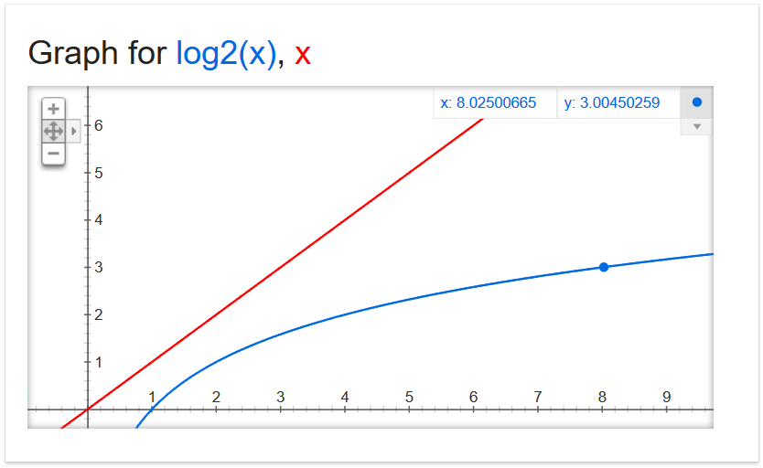
Why Care?

Slide 31
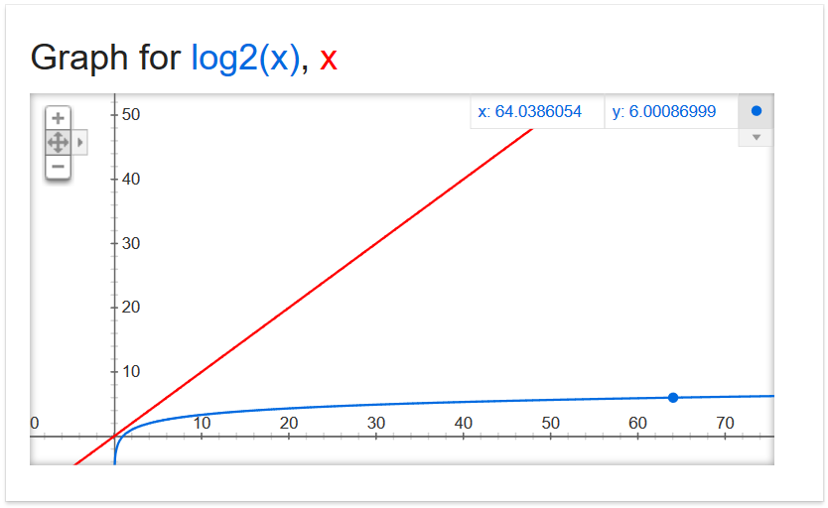
Why Care?

Slide 32
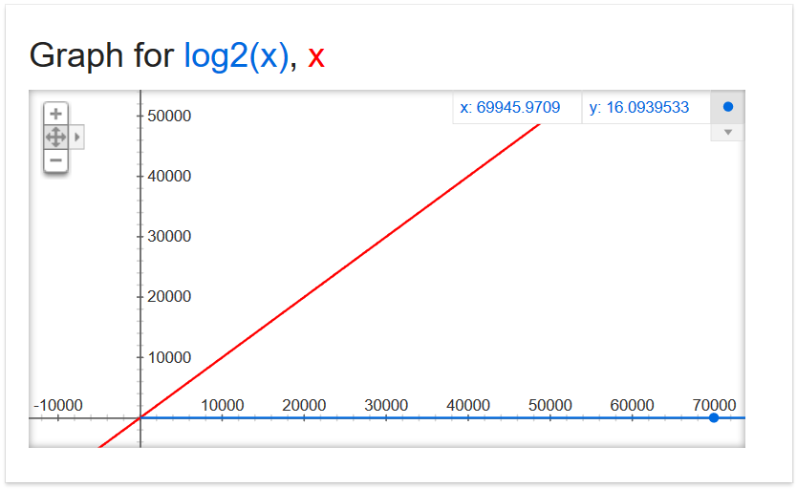
Why Care?

Slide 33
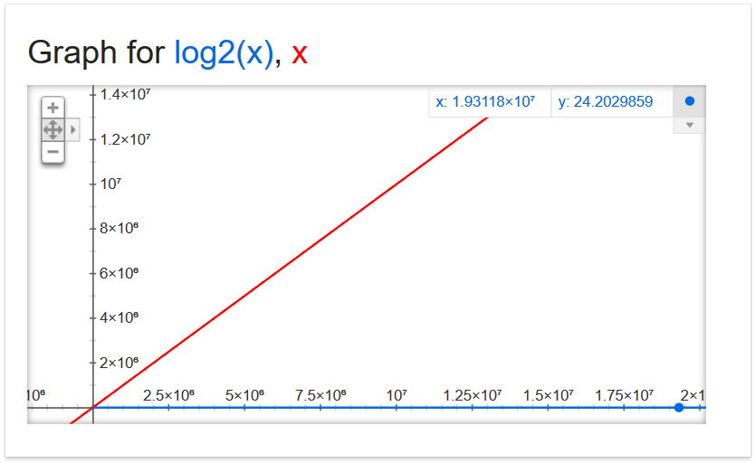
Why Care?
19,311,800

Slide 34
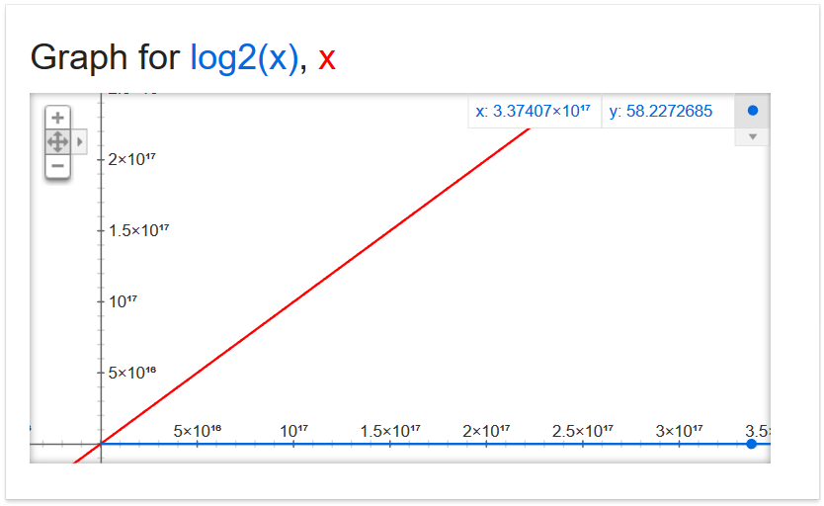
Why Care?
337,407,000,000,000,000

Slide 35
Why Care?
For large problems, there’s a huge difference!
If we can do 1,000,000 operations per second, and the list is 337.4 quadrillion items
  Binary search takes 0.000058 seconds
  Linear search takes 337,407,000,000 seconds
  5,623,450,000 minutes
  93,724,166 hours
  3,905,173 days
  10,699 years

Slide 36

Daily CS History
Hedy Lamarr
  Film star in 1930s - 1950s
  Patented a frequency-hopping system that would make radio-guided torpedoes hard to detect or jam during World War II
  Technologies like Bluetooth and Wi-Fi use similar methods

Slide 37
Announcements
Project 3 is due on Friday, May 11th
Assignments out now
  Survey #3
  Final exam metacognition quiz out on BB same day
Course evaluations also out, please complete
Final exam is Friday, May 18th from 6 to 8 PM

Slide 38
Final Exam Locations
Find your room ahead of time!
Engineering 027 - Sections 8, 9, 10, 11, 12
Section 6
Meyerhoff 030 - Sections 2, 3, 4, 5
Sections 14, 15, 16, 17, 30

Slide 39
Image Sources
Alphabetizing a Bookshelf video screenshot:
  https://www.youtube.com/watch?v=WaNLJf8xzC4
Graphs of x and log₂(x) courtesy of Google equation grapher
Hedy Lamarr:
  https://commons.wikimedia.org/wiki/File:Hedy_lamarr_-_1940.jpg

